Slide 1
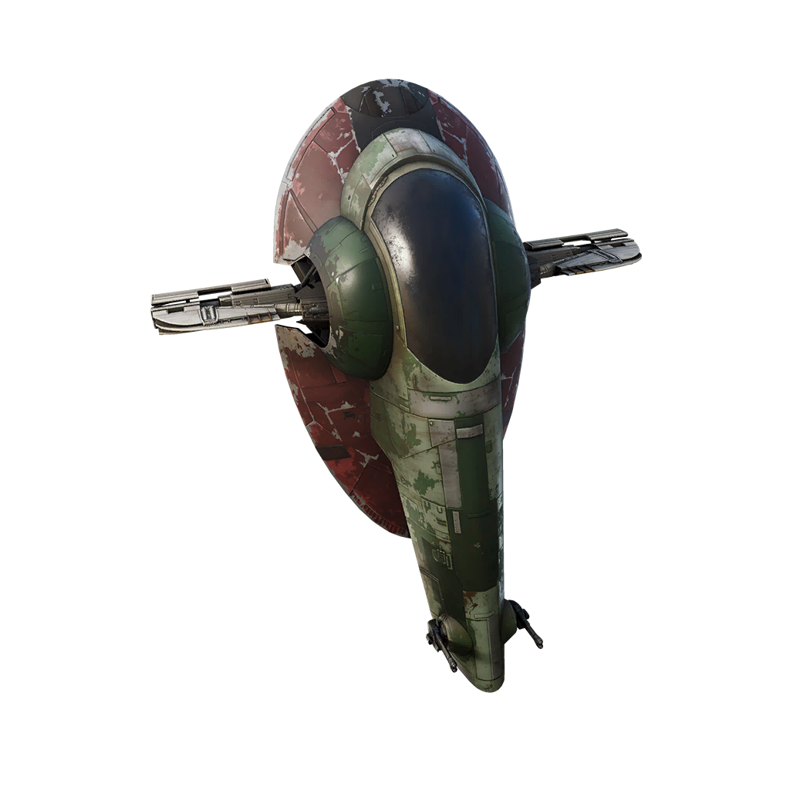
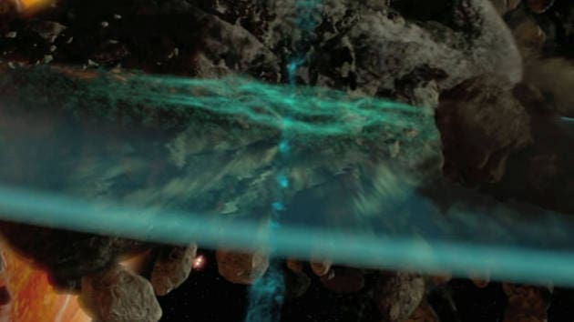
Star wars TM seismic charge CGP SHADER MINI-PROJECT
Tonko Bossen
Aalborg University, Medialogi 5
2. dec. 2022
Notes:
https://www.starwars.com/video/seismic-charges

Slide 2
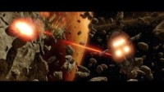

Slide 3


Slide 4


Slide 5
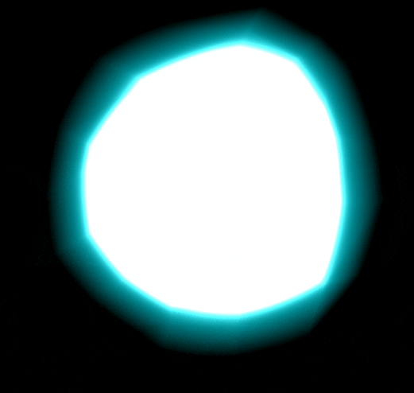
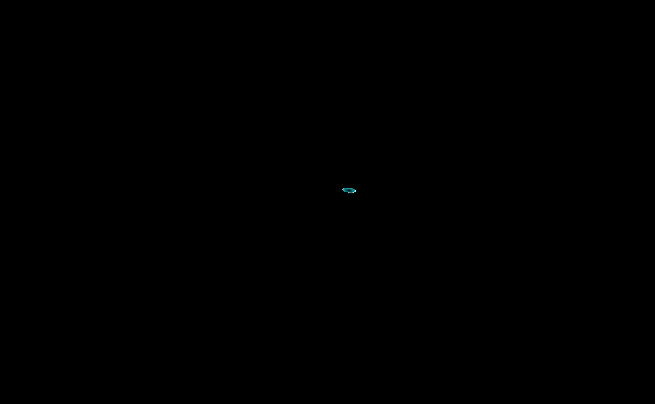
3 major elements
Bloom glimt
Smoke & cones wind-up
Disc expanding

Slide 6
Bloom glimt
Relative distance to camera
Scale relative alpha and highlighted color fresnel

Slide 7
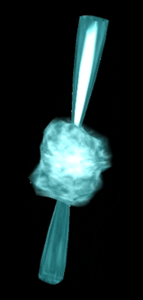
Smoke wind-up
Scale relative distortion using noise texture
Alpha and highlighted color fresnel
Smoke layering using noise texture
Flashing using hard noise texture

Slide 8
Cones wind-up
Fixed scale
Cut off
Curvature using normal and sin of y-values
Inner fresnel

Slide 9
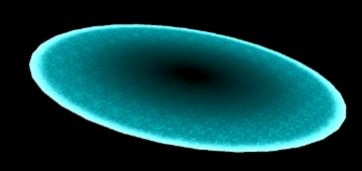
Disc expanding
Texture highlighting
Intensity animation
White light outer rim
Fade out after specific size

Slide 10
General
Clipping depended to size and positive/negative values

Slide 11
Fresnel

